Slide 1


Slide 2



PREMIER SPONSOR

Slide 3

Every story matters.
Bet on recovery and help
build brighter futures.

Slide 4

PREMIER SPONSOR

Slide 5


LIVE AUCTION
BEGINS AT
8:30 PM

Slide 6

PREMIER SPONSOR

Slide 7

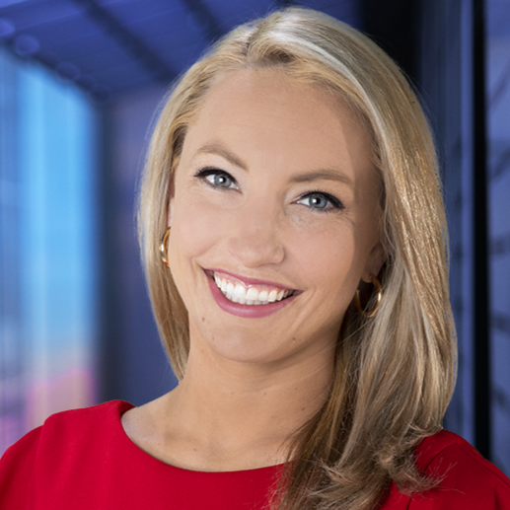
THANK YOU
MOLLY REED
We are grateful for your role as the emcee at
the Betting on Recovery CAsino Gala Night
Your presence made the evening truly special.

Slide 8


ROYAL FLUSH SPONSOR

Slide 9


FULL HOUSE SPONSOR
07.

Slide 10

ROYAL FLUSH SPONSOR

Slide 11

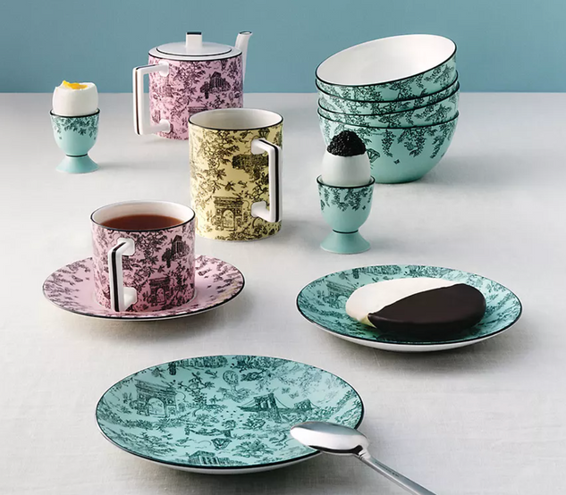
LIVE AUCTION
FEEL LIKE AUDREY HEPBURN FOR THE DAY WITH A MAKEOVER AND BREAKFAST AT TIFFANY FOR YOU
AND 9 OF YOUR FRIENDS

Slide 12
OUR MISSION
Foundation’s mission is to provide individuals seeking recovery from substance abuse disorders with a safe, structured, and supportive home-like environment that fosters recovery, personal growth, and civic responsibility. Foundation’s goal is to help each and every client reclaim their dignity and acquire the knowledge, skills, support, and resources they will need to maintain a drug free, purposeful, and productive life.
As a community-based non-profit, Foundations' commitment is to extend a helping hand to every qualified applicant who sincerely desires recovery.

Slide 13

ROYAL FLUSH SPONSOR

Slide 14

FULL HOUSE SPONSOR
07.

Slide 15

ROYAL FLUSH SPONSOR

Slide 16


Client Testimonial
Foundations to Freedom saved my life. I wish I had found this place years ago. The staff is amazing; it’s not like any other place I have been.—Ashley

Slide 17

ROYAL FLUSH SPONSOR

Slide 18

FULL HOUSE SPONSOR
07.

Slide 19

ROYAL FLUSH SPONSOR

Slide 20
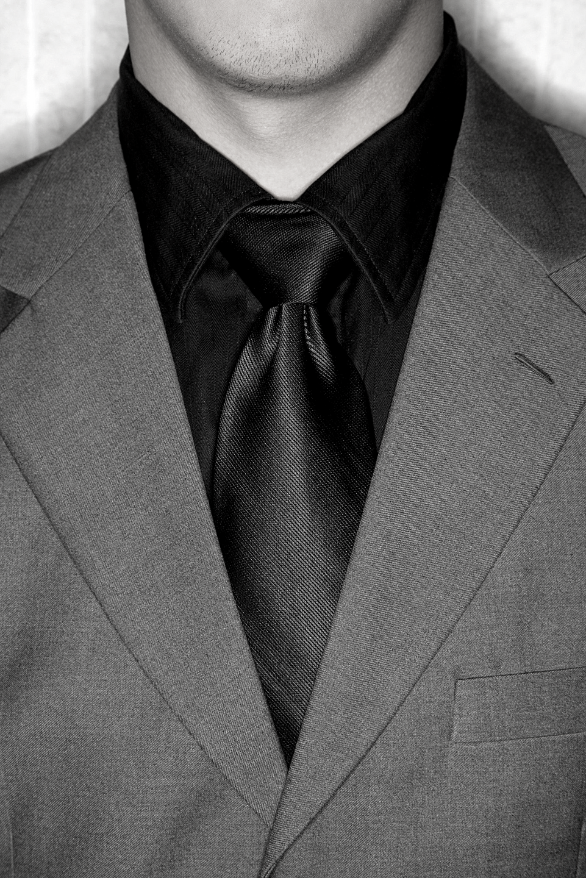
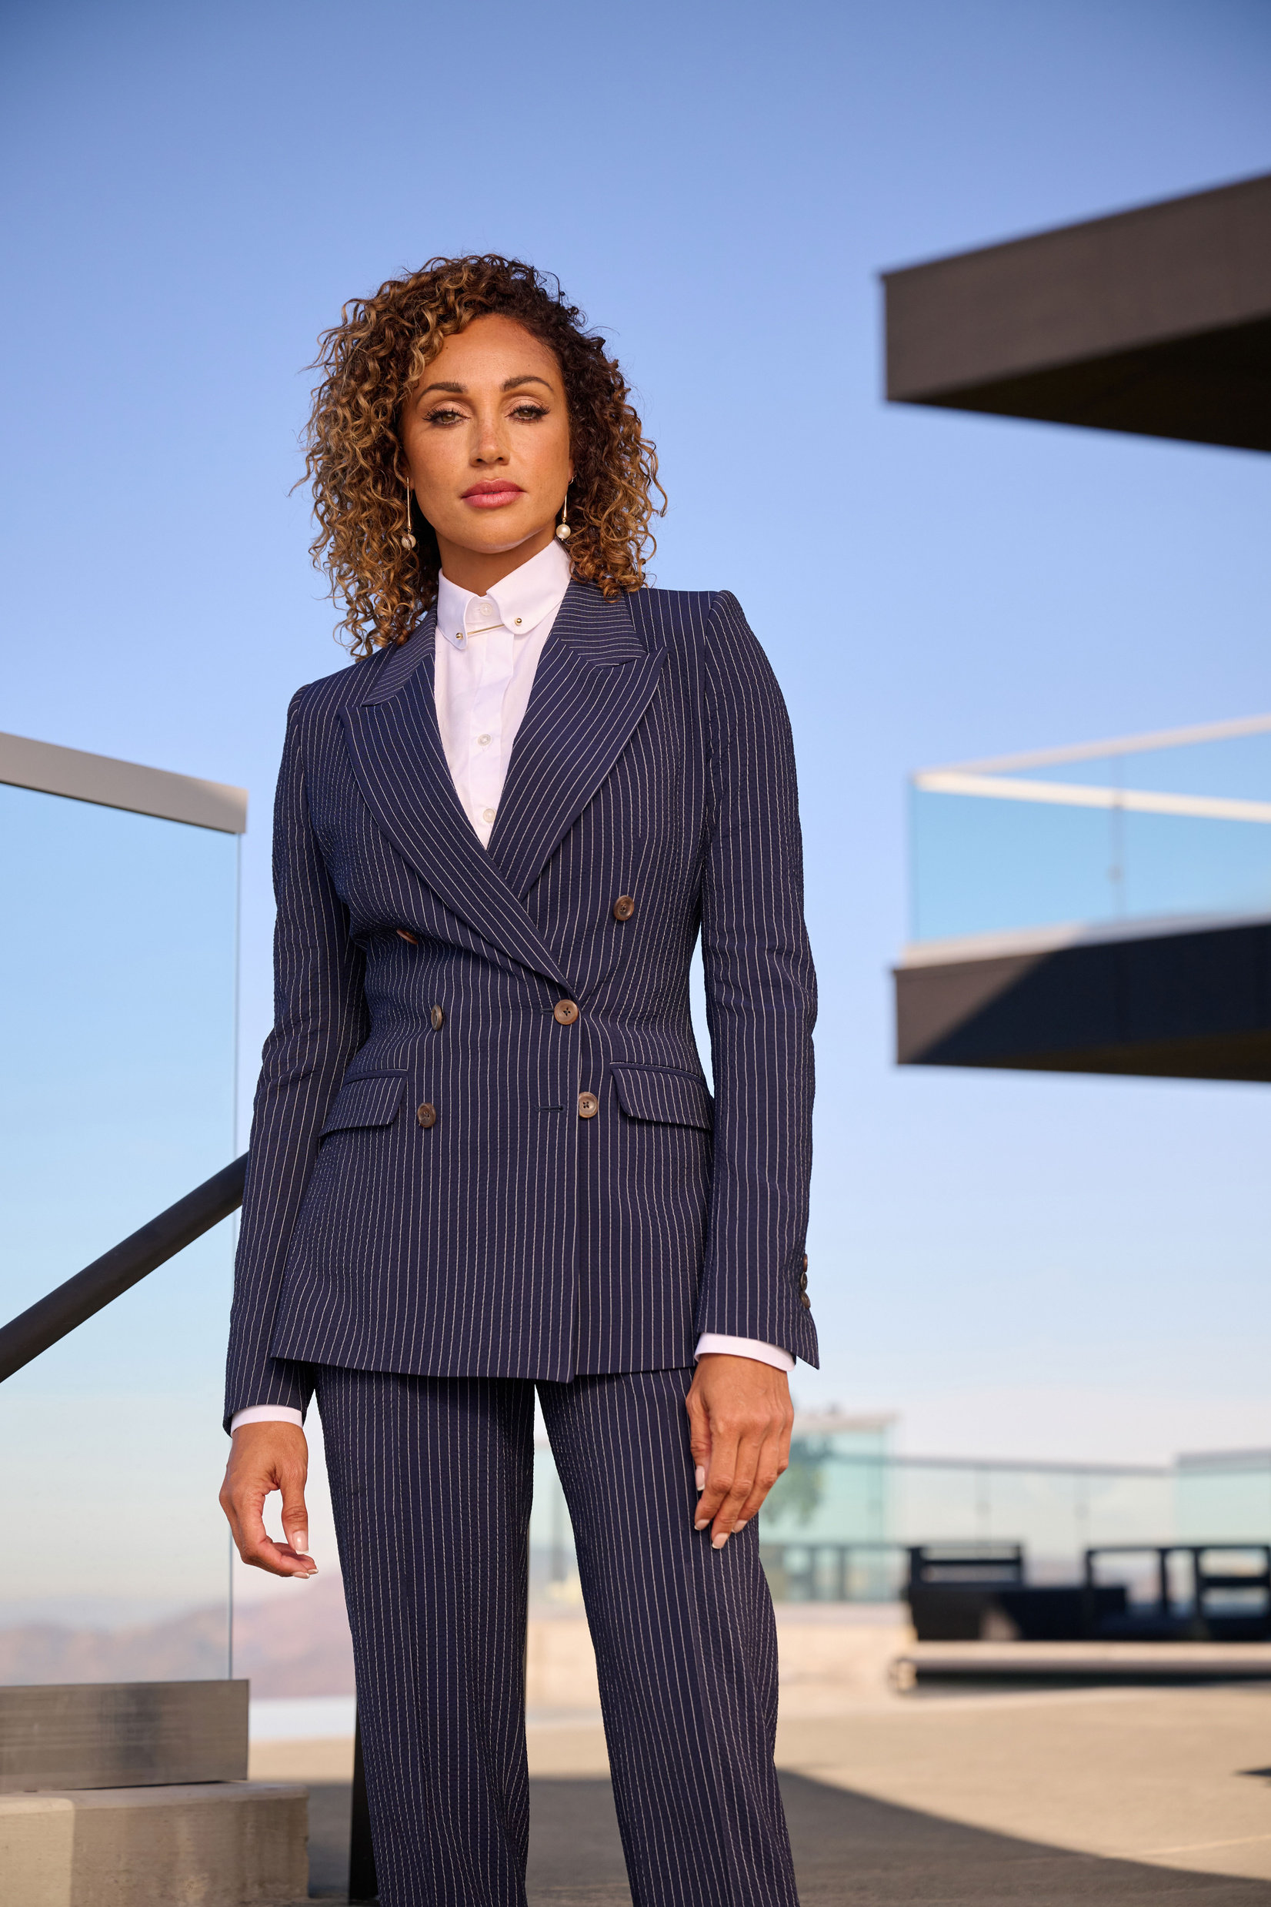
LIVE AUCTION
TOM JAMES CUSTOM MADE SUIT
FOR HIM OR FOR HER

Slide 21
OUR COMMITMENT
At the heart of Foundations To Freedom is the story of our founder,
Katherine Russell. Katherine's own journey from a life-altering car accident to triumph over addiction fuels our mission. As the Executive Director, Katherine's profound understanding of the recovery process shapes the very essence of our approach.

Slide 22

ROYAL FLUSH SPONSOR

Slide 23

FULL HOUSE SPONSOR
07.

Slide 24

ROYAL FLUSH SPONSOR

Slide 25

Client Testimonial
Foundations to Freedom has provided me a chance to start a new way of life! Everyone from the staff from the executive director to the counselors, coordinators, etc...are top-notch and very compassionate about helping people! —Bernard

Slide 26

ROYAL FLUSH SPONSOR

Slide 27

FULL HOUSE SPONSOR
07.

Slide 28

ROYAL FLUSH SPONSOR

Slide 29

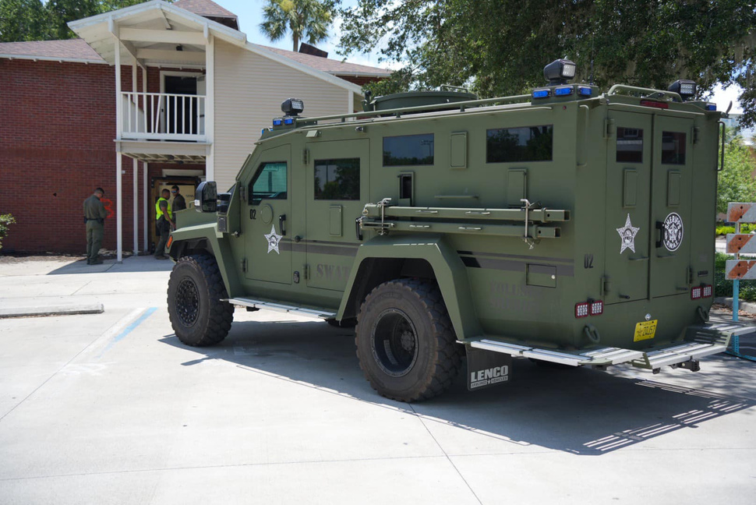
LIVE AUCTION
SWAT EXPERIENCE (8) PEOPLE

Slide 30
OUR VISION
We believe that true recovery encompasses more than abstaining from substances;
it's about reclaiming your sense of self, discovering resilience,
and fostering personal growth. Our comprehensive programs offer not only a
roadmap to sobriety but also the tools, resources, and steadfast support needed.

Slide 31

ROYAL FLUSH SPONSOR

Slide 32

FULL HOUSE SPONSOR
07.

Slide 33

ROYAL FLUSH SPONSOR

Slide 34

Client Testimonial
Foundations to Freedom was life- transforming for our son. They gave him the tools and opportunities to beat his addiction and start living his life to his full potential. —Rhonda

Slide 35

ROYAL FLUSH SPONSOR

Slide 36
FULL HOUSE SPONSOR
Judy Thompson
07.

Slide 37

ROYAL FLUSH SPONSOR

Slide 38
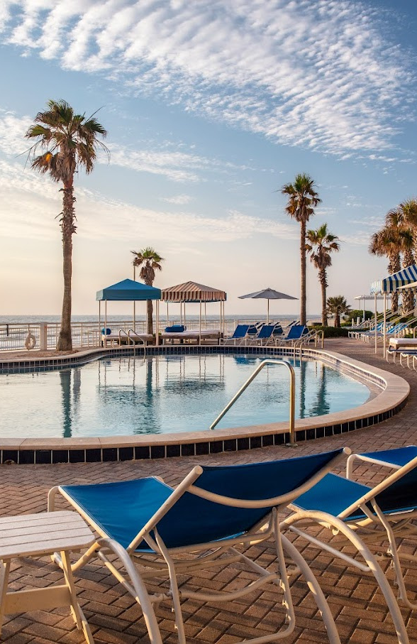
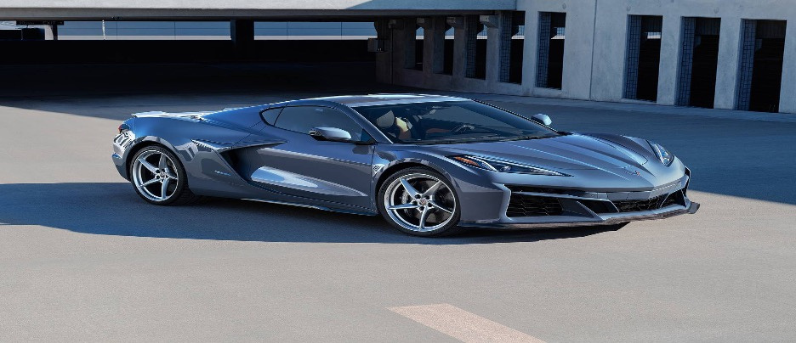
LIVE AUCTION
THE SHORES RESORT AND LUXURY CAR RENTAL

Slide 39
OUR TEAM
At Foundations To Freedom, our team is a family of compassionate
professionals who understand the complexities of substance use disorder.
With experienced therapists, dedicated case managers, and empathetic staff, we
stand beside you, drawing from our own journeys to provide unwavering guidance.

Slide 40

ROYAL FLUSH SPONSOR

Slide 41





ROULETTE SPONSORS

Slide 42
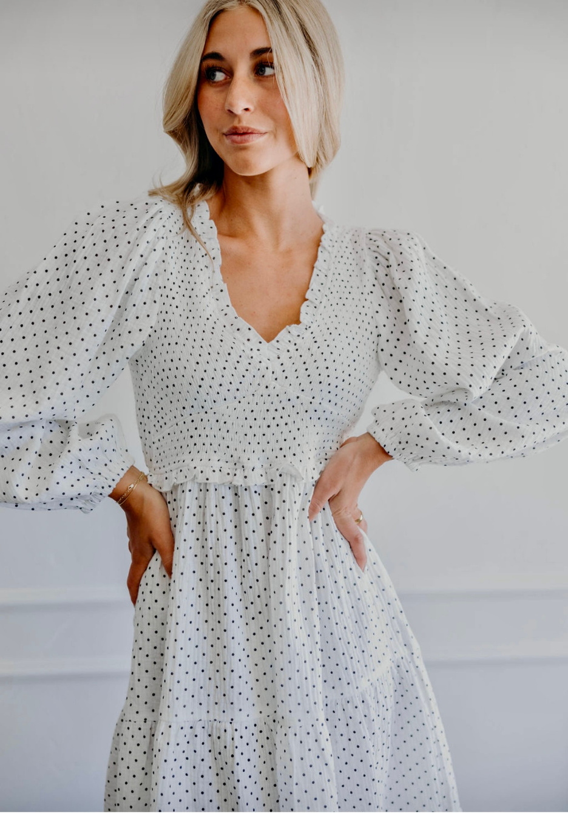

LIVE AUCTION
INDULGENCE SHOPS
ORLANDO PACKAGE

Slide 43

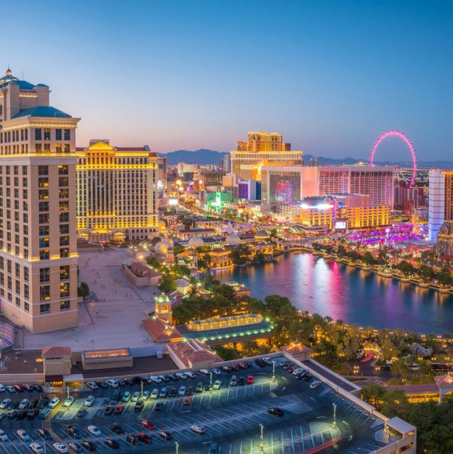
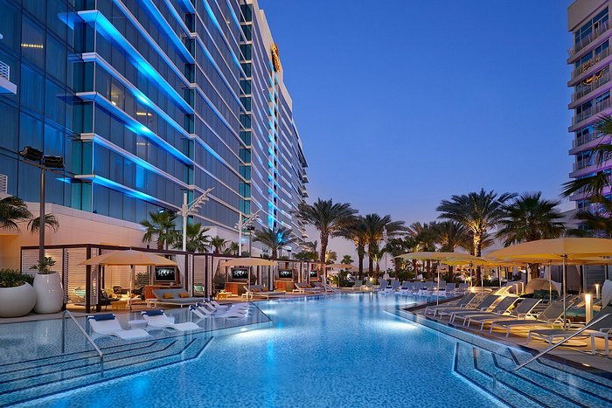
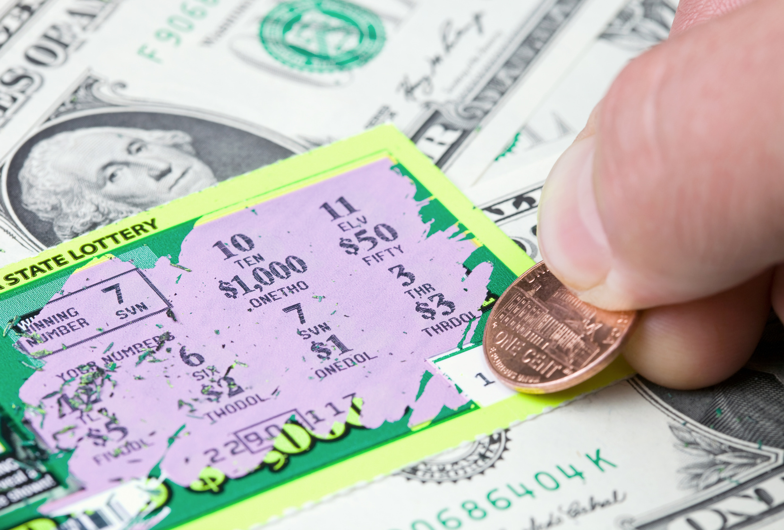
CASINO WINNERS
FIRST PRIZE
Las Vegas Hotel
SECOND PRIZE
THIRD PRIZE
Hard Rock Tampa
Lottery Ticket Basket
06.

Slide 44




HIGH ROLLER SPONSORS

Slide 45

Client Testimonial
This recovery program is wonderful! I’ve had the opportunity to come to their program and I couldn't have found a better place. There is so much support! Foundations to Freedom really does go above and beyond for their clients!—Danielle

Slide 46












TEXAS HOLD ‘EM SPONSORS
Julia Silveira
David Santiago
COUNCILMAN
VOLUSIA COUNTY

Slide 47


LIVE AUCTION
DISNEY SPRINGS EXPERIENCE

Slide 48

Gorgeous Ladies of Worth
GLOW
Fashion Show
SHINE BRIGHT
LIKE A DIAMOND
MAY 18, 2025

Slide 49
SPECIAL THANKS TO THESE SUPPORTERS
Bernice & Pearl
DeLand Pilates
DR. ROBERT URBAN
Elusive Grape
Face it
Hand & Stone | DeLand
Hunters & Gatherers
Lace & Accessories
Local Style House
MIRROR MIRROR
Sassy Stylers
Senders Retreat
Shellsea
Style House
PES Benefits

Slide 50
SAVE
THE
DATE
October 11, 2025

Slide 51
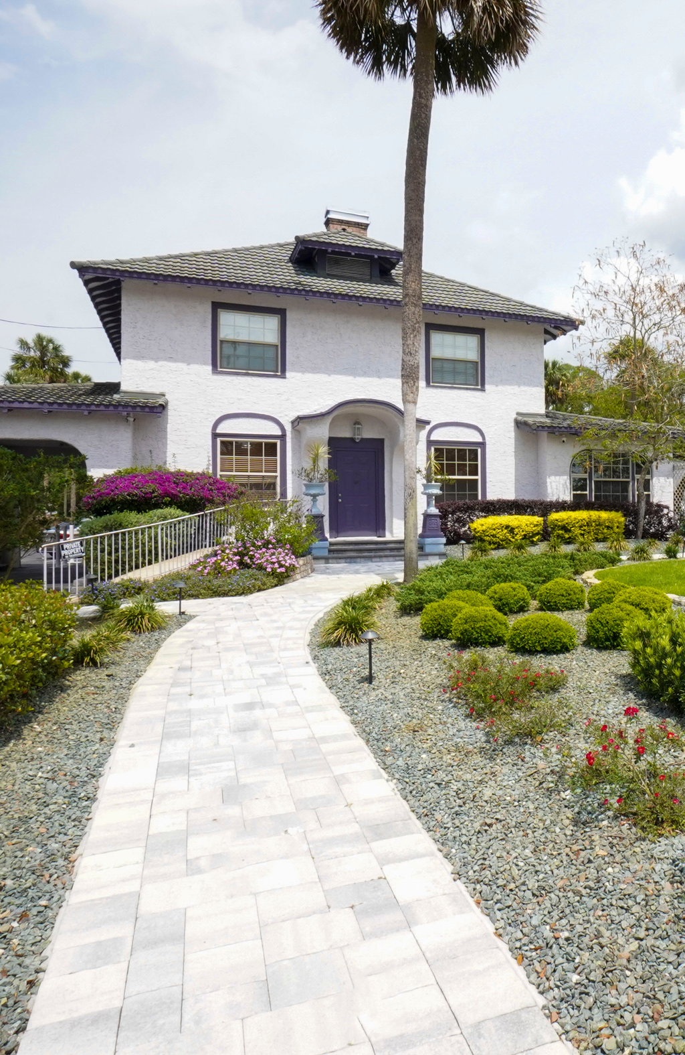
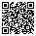
THANK YOU

